Slide 1

CEREBRO-X : An AI-Powered Digital Brain Twin Framework for Alzheimer's Disease Progression Prediction
M. Tech Dissertation – I
Presented by
ARYAN SHARMA (25MCS1018)
M.Tech Computer Science and Engineering
Under the Guidance of
Dr. Sridevi S.
Associate Professor
School of Computer Science and Engineering
Vellore Institute of Technology, Chennai.

Slide 2
CONTENTS
INTRODUCTION
LITERATURE SURVEY
RESEARCH GAPS
OBJECTIVES
PROPOSED SOLUTION TO THE PROBLEM
ARCHITECTURE
DATASET DESCRIPTION
MODULES DESCRIPTION
IMPLEMENTATION
EVALUATION METRICS & RESULTS
GUIDE APPROVAL
TIMELINE / GANTT CHART
REFERENCES

Slide 3
1. PROBLEM STATEMENT
Alzheimer's disease is a progressive neurodegenerative disorder causing gradual cognitive decline. Existing AI systems mainly focus on static diagnosis/classification from individual MRI scans.
They often fail to model patient-specific disease progression over time. MRI, clinical history and cognitive assessments are frequently analyzed separately. Many deep-learning models provide predictions without sufficient interpretability.
There is a need for an explainable, longitudinal and personalized AI framework for Alzheimer's progression monitoring.
Existing Alzheimer's AI systems largely provide point-in-time predictions rather than a continuously evolving, explainable representation of an individual patient's disease progression.

Slide 4
2. INTRODUCTION
Alzheimer’s disease (AD) is a progressive neurodegenerative disorder that causes memory loss, cognitive decline, and gradual loss of functional abilities. MRI and clinical assessments provide valuable information about structural and cognitive changes associated with disease progression.
Existing AI-based approaches mainly focus on disease classification or detection at a single point in time. These approaches often have limited ability to represent individual patient trajectories, integrate multiple data types, and explain their predictions.
Cerebro-X proposes an AI-powered Digital Brain Twin that integrates longitudinal MRI, clinical, and cognitive information to create a patient-specific representation of disease progression.
The framework aims to predict future progression, provide explainable insights, and support clinical decision-making.

Slide 5
3.LITERATURE SURVEY
S.No | Article Title | Techniques Used | Key Findings | Limitations
1 | Predicting Alzheimer’s Disease Progression Using Multi-Modal Deep Learning Approach (Lee et al., 2019) | Multimodal RNN; MRI + CSF + cognitive data | Longitudinal multimodal learning achieved 81% accuracy, AUC 0.86 for MCI→AD prediction. | Requires multiple data modalities.
2 | A Deep Learning Model for Early Prediction of Alzheimer’s Disease Dementia Based on Hippocampal MRI (Li et al., 2019) | Deep learning + time-to-event analysis | Achieved C-index 0.762 on ADNI and 0.781 on AIBL; combining clinical measures increased C-index to 0.864. | Focuses primarily on MCI→AD progression; does not provide a continuously updated patient representation.
3 | Deep Residual Learning for Neuroimaging: An Application to Predict Progression to Alzheimer’s Disease (Abrol et al., 2020) | ResNet + domain transfer learning | Achieved 83.01% test accuracy for progression-related MRI classification. | Primarily MRI-based classification; limited multimodal and longitudinal patient modeling.
4 | Multimodal Deep Learning for Alzheimer’s Disease Prediction (Basahel et al., 2021) | Multimodal deep learning | Demonstrated benefits of combining MRI, clinical and genetic information for AD prediction. | Focus remains prediction/classification rather than a continuously evolving Digital Brain Twin.

Slide 6
LITERATURE SURVEY (CONTD..,)
S.No | Article Title | Techniques Used | Key Findings | Limitations
5 | Longitudinal MRI-Based Alzheimer’s Disease Progression Modeling (2024) | CNN + BiLSTM | Combines spatial MRI features with temporal information to model longitudinal disease progression. | Temporal modeling is present, but patient-specific Digital Twin representation and integrated clinical decision support are limited.
6 | Smart ROI Detection for Alzheimer’s Disease Prediction Using Explainable AI (Aghaei et al., 2023) | 3D CNN + Grad-CAM + automatic ROI extraction | On 176 MCI ADNI subjects, reported 98.6% accuracy and AUC 1.0 using 5-fold CV. | Strong XAI component, but focused on ROI-based prediction rather than longitudinal Digital Twin modeling.
7 | An Integrated Predictive Model for Alzheimer’s Disease Progression from Cognitively Normal Subjects Using Generated MRI and Interpretable AI (Aghaei & Moghaddam, 2025) | Ensemble transfer learning + ViT-GAN + 3D CNN + Grad-CAM | Generated future MRI changes and predicted CN→AD progression; reported 0.85 accuracy and 0.86 F1-score. | Synthetic MRI generation introduces additional assumptions; primarily focuses on progression prediction rather than a complete Digital Twin framework.

Slide 7
LITERATURE SURVEY (CONTD..,)
S.No | Article Title | Techniques Used | Key Findings | Limitations
8 | Longitudinal MRI + Radiomics for Alzheimer’s Progression Prediction (2025) | Radiomics + longitudinal modeling | Shows that longitudinal structural MRI features can support MCI→AD progression prediction. | Hand-crafted/radiomic features may not capture the full multimodal patient representation.
9 | MRI and Clinical Data for Prediction of 12-Month Cognitive Decline (2026) | Machine learning + MRI + clinical features | Demonstrates the value of combining routine clinical variables with MRI for predicting near-term cognitive decline. | Short prediction horizon; does not maintain a longitudinal Digital Brain Twin.
10 | Multimodal MRI + Clinical Explainable AI Framework (2026) | Transformer-based fusion + Grad-CAM + SHAP | Combines imaging and clinical information while providing both visual and feature-level explanations. | Explainability and multimodal fusion are addressed, but continuous patient-specific Digital Twin modeling remains limited.

Slide 8
4. RESEARCH GAPS
Identified Research Gaps:
1. Static Prediction
Most systems focus on diagnosis at a single time point.
2. Limited Patient Personalization
Population-level models do not fully represent an individual's disease trajectory.
3. Fragmented Multimodal Analysis
MRI, clinical and cognitive information are often processed separately.
4. Limited Longitudinal Modeling
Many approaches do not maintain a continuously evolving patient representation.
5. Explainability Gap
Predictions are often not sufficiently interpretable for clinical users.
6. Generalization Gap
Many models are evaluated within the same dataset rather than using independent cohorts.

Slide 9
5. OBJECTIVES
Objectives of Cerebro X :
To develop a multimodal AI system that analyzes MRI, EEG, and clinical data for Alzheimer’s disease assessment.
To detect and classify cognitive impairment and estimate the current stage of Alzheimer’s disease using machine learning/deep learning techniques.
To predict disease progression longitudinally by analyzing changes in patient data across multiple time points.
To provide explainable and interpretable predictions using XAI techniques such as Grad-CAM and SHAP, helping clinicians understand the factors influencing the model’s decision.

Slide 10
6. PROPOSED SOLUTION
Cerebro X proposes a multimodal AI-based framework that combines MRI scans, EEG signals, and clinical information to assess Alzheimer’s disease. This allows the system to use complementary information from different patient data sources.
The system will use deep learning and machine learning models to identify cognitive impairment and classify the patient’s condition. It will also analyze longitudinal patient data to identify patterns and estimate possible disease progression.
To improve transparency, Cerebro X will incorporate Explainable AI techniques such as Grad-CAM and SHAP to show which features influenced the prediction. This makes the system more interpretable and potentially useful as a clinical decision-support tool.
MRI + EEG + Clinical Data → Multimodal AI Model → Alzheimer’s Assessment → Progression Prediction → XAI Explanation

Slide 11
7. ARCHITECTURE
Cerebro X: Proposed Solution
Data Acquisition
Collect longitudinal clinical, cognitive, MRI, and EEG data.
Preprocessing
Clean, normalize, and align patient data across visits.
Feature Extraction
Extract meaningful clinical, MRI-derived, and EEG spectral features.
Multimodal Fusion
Integrate information from different modalities for a unified patient representation.
Digital Brain Twin
Generate a personalized 64-dimensional latent representation that evolves across patient visits.
Disease Progression Prediction
Predict the next-visit CDR stage and estimate disease progression/risk.
Explainable AI (XAI)
Provide interpretable predictions using SHAP-style clinical attribution and the planned MRI Grad-CAM pipeline.
Decision Support & Visualization
Display patient history, predictions, progression trends, and explanations through the Next.js dashboard.

Slide 12
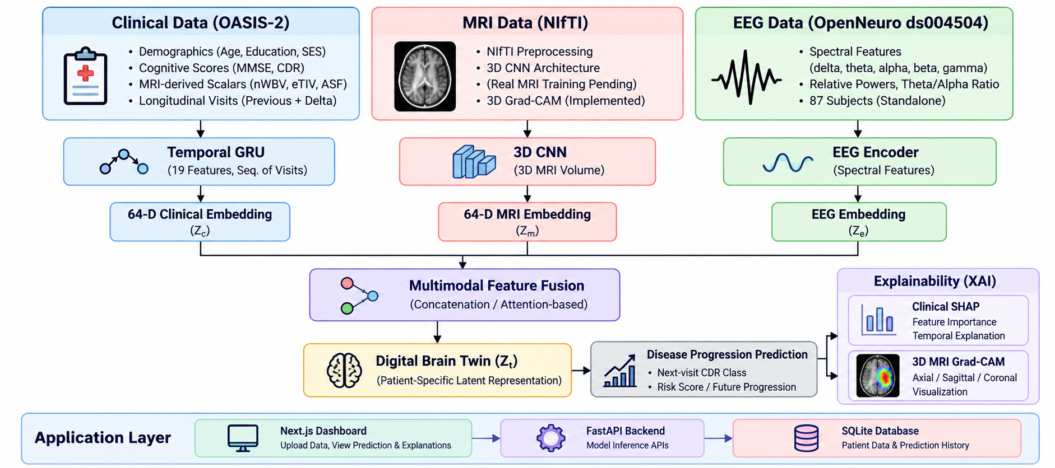

Slide 13
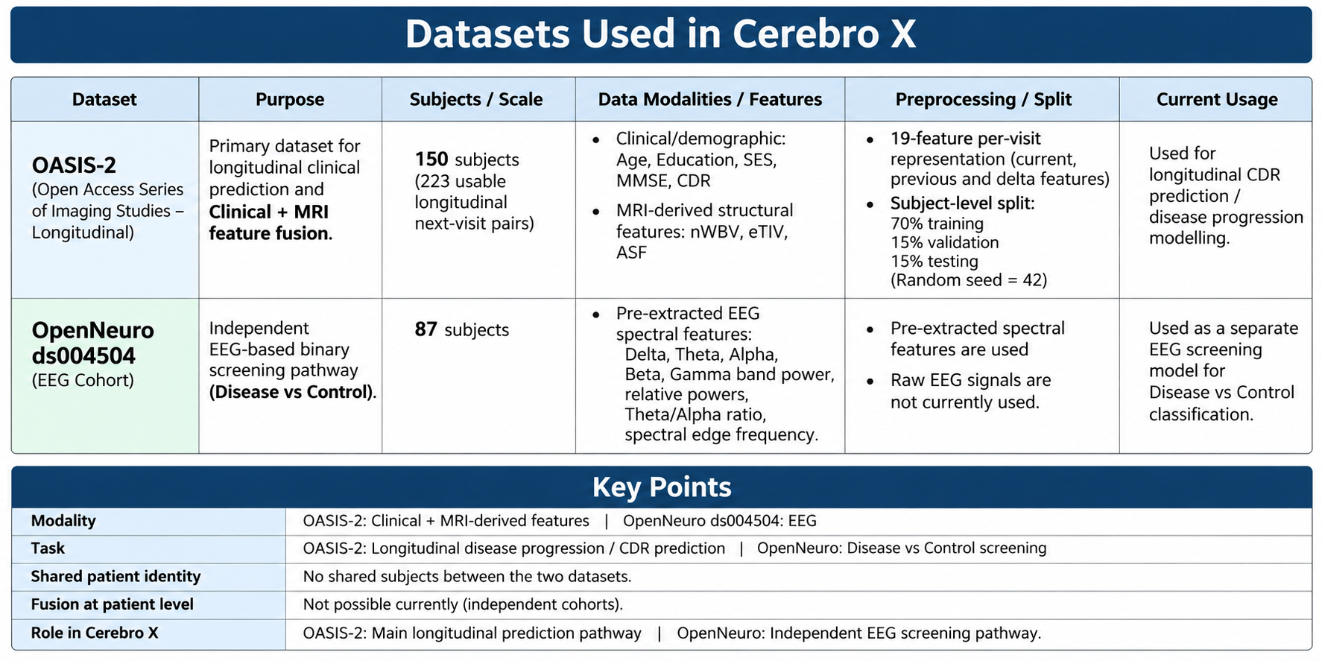
8. DATASET DESCRIPTION

Slide 14
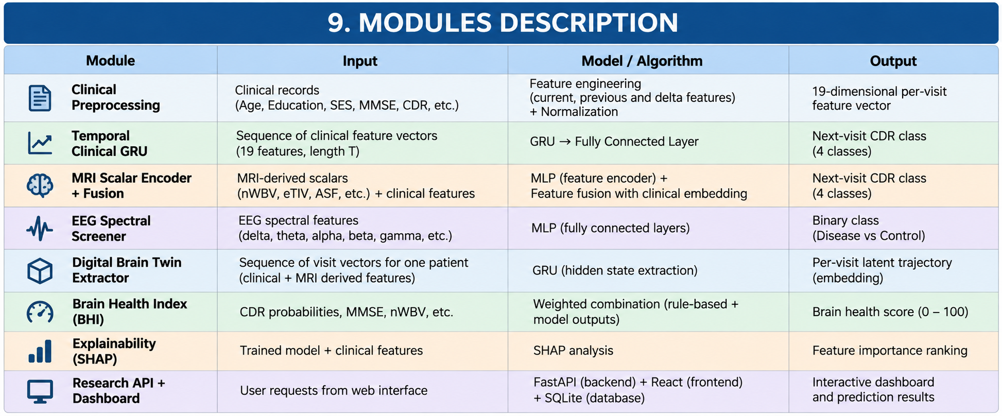
9. MODULES DESCRIPTION

Slide 15
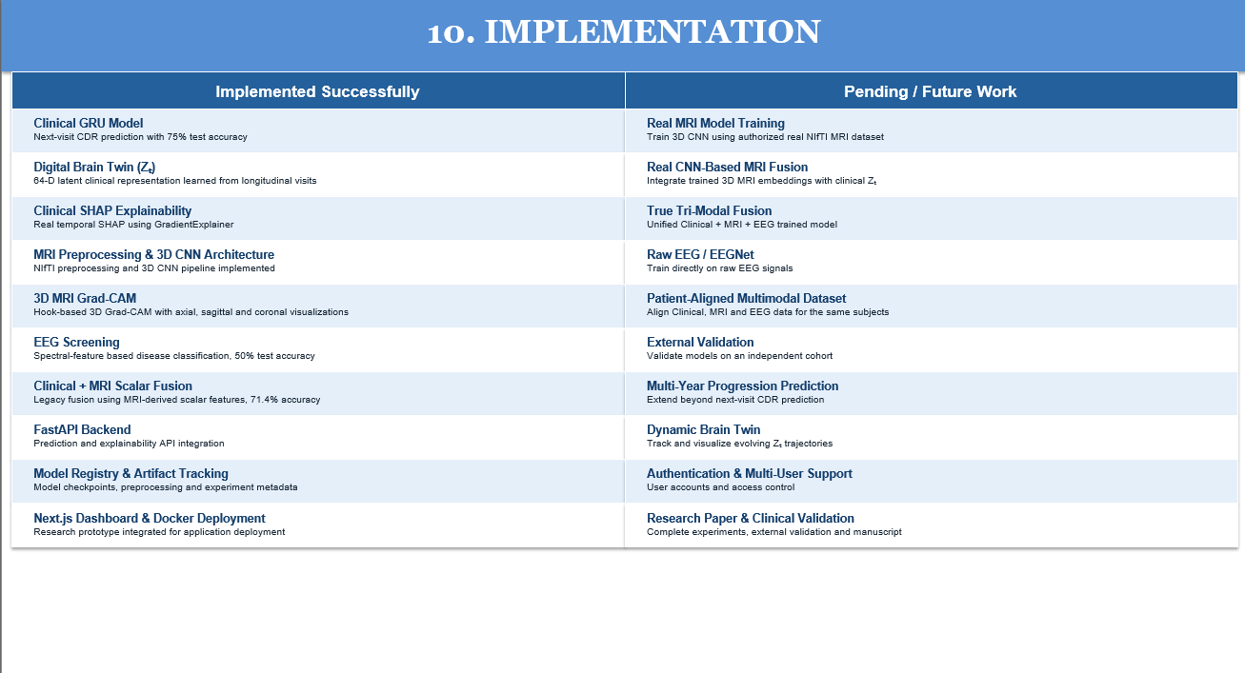

Slide 16
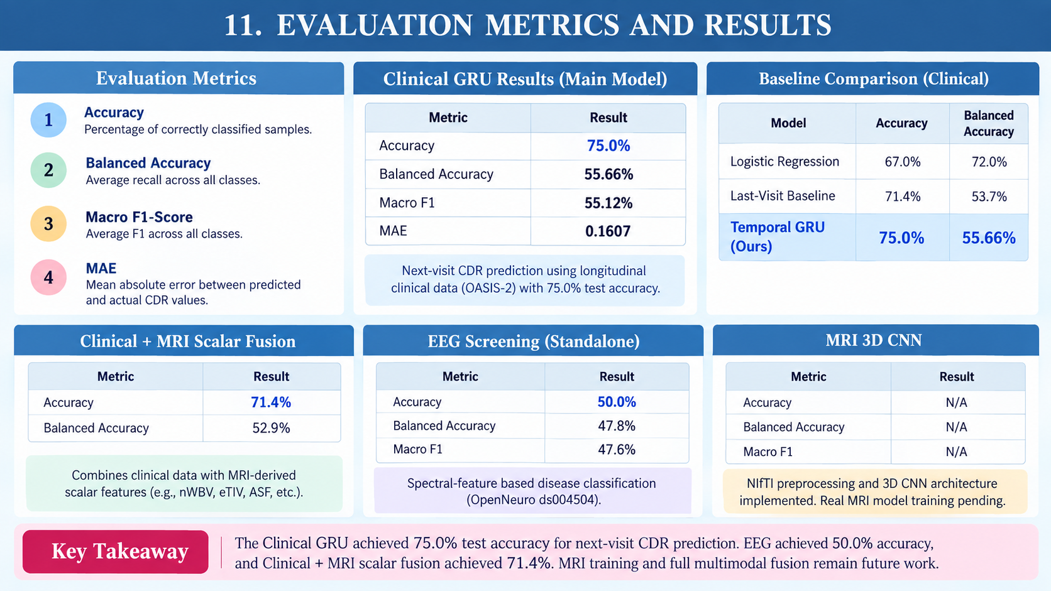
11. EVALUATION METRICS

Slide 17
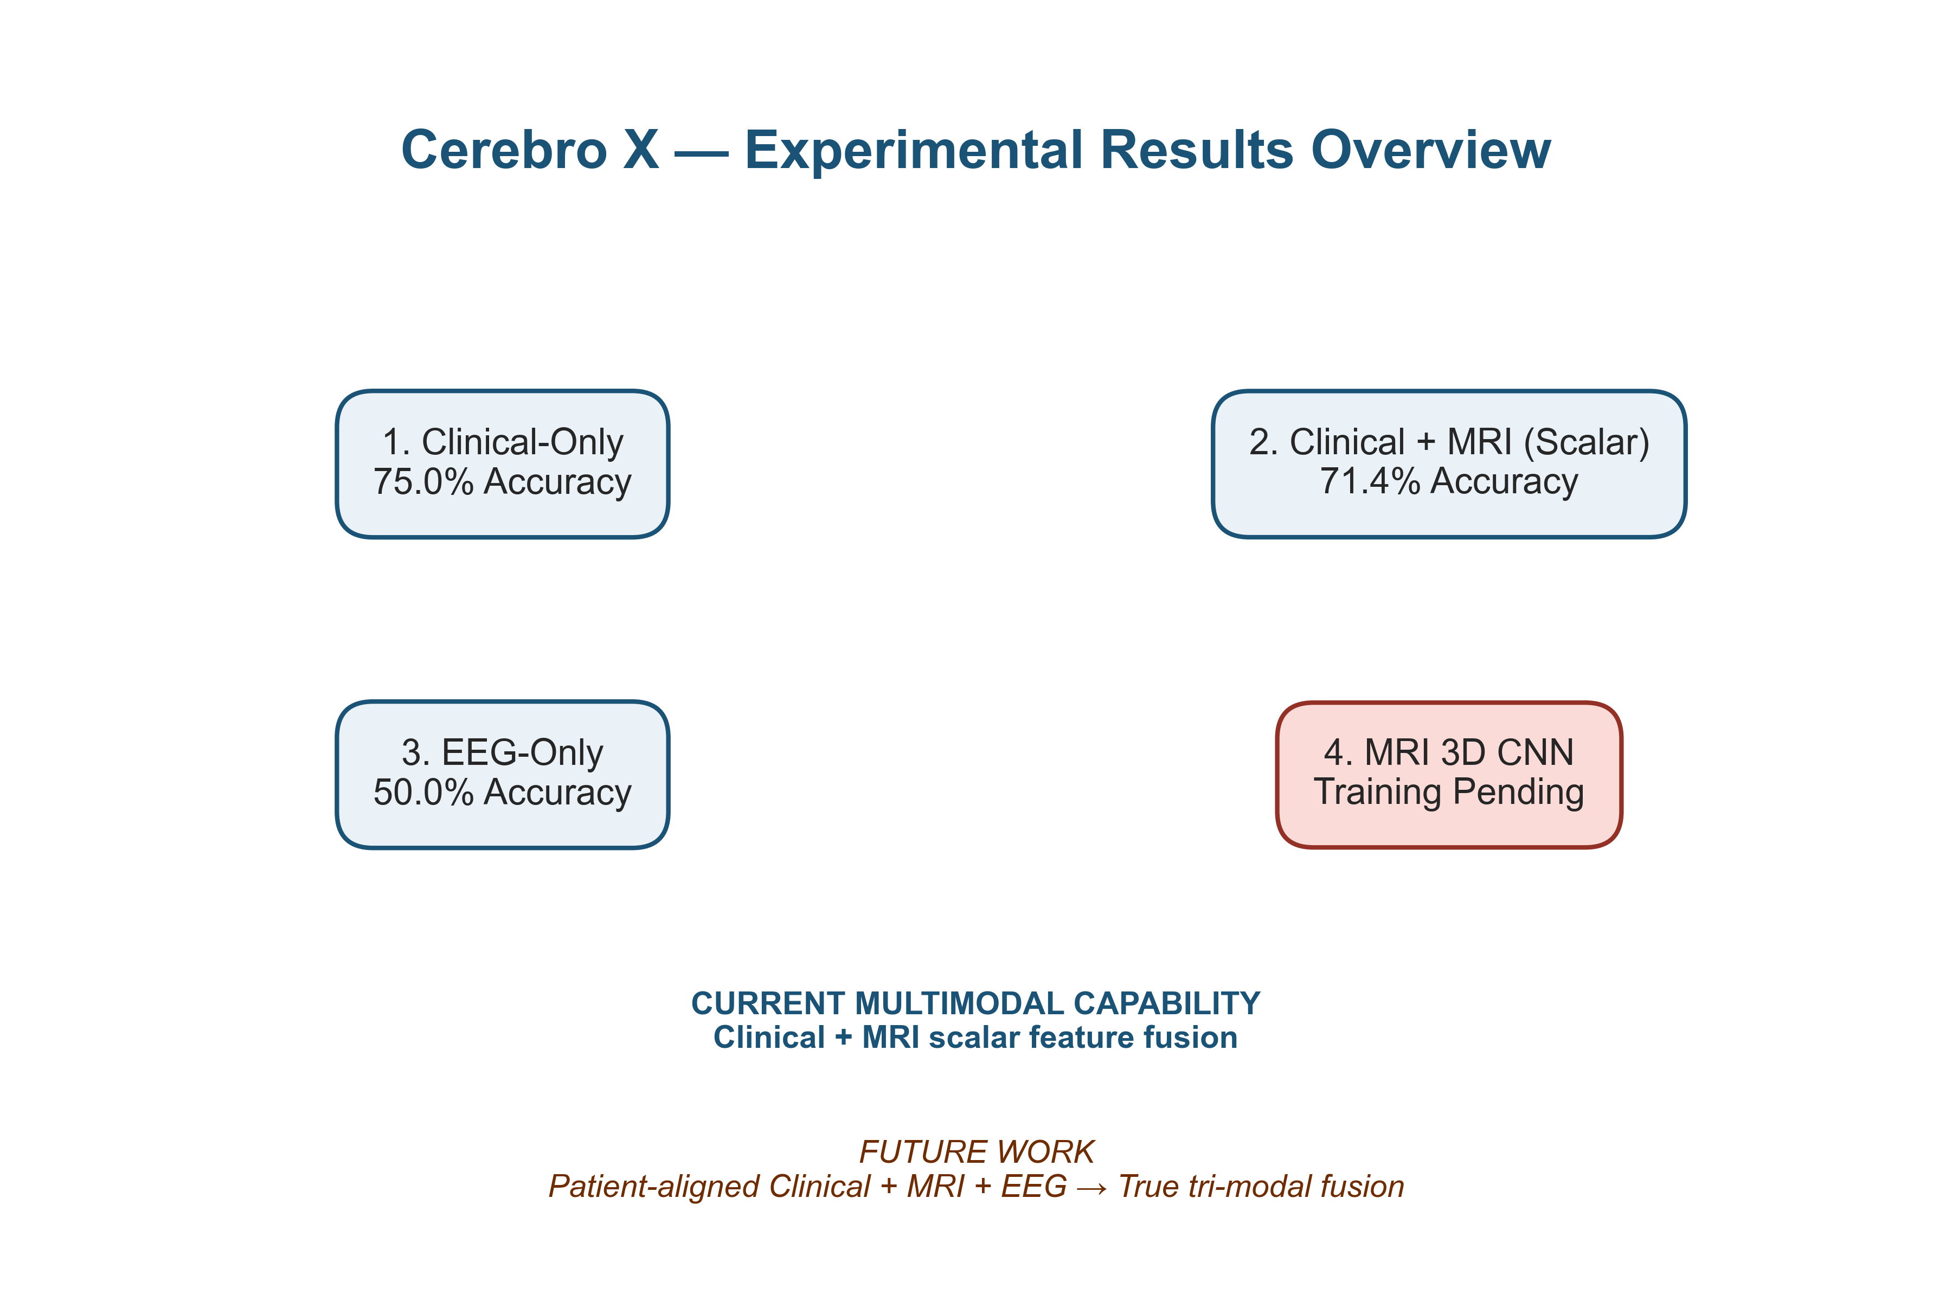

Slide 18
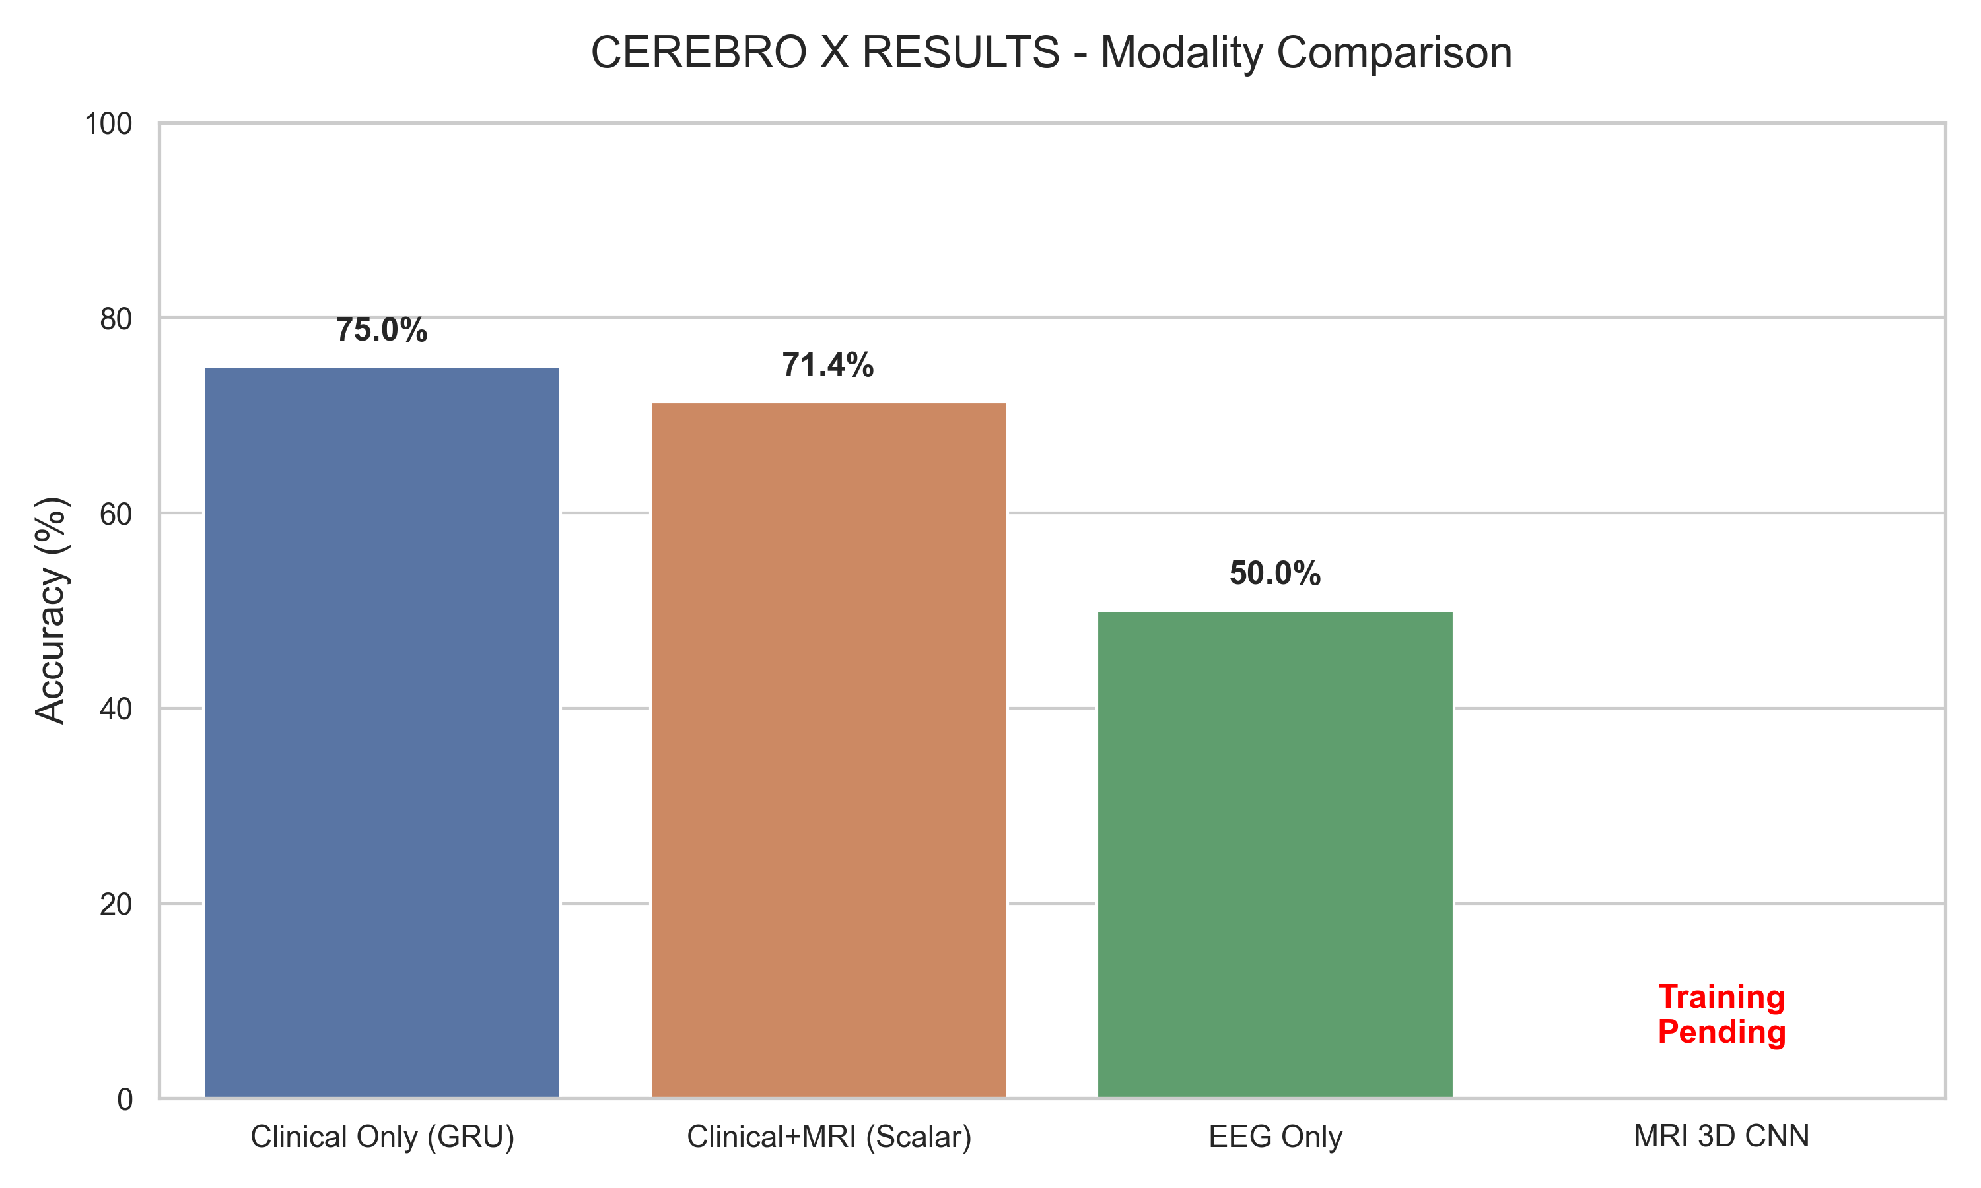

Slide 19
12. TIMELINE / GANTT CHART
S.No. | Months | Task / Activity | Milestone / Expected Outcome
1 | June–July | Problem Definition & Literature Review | Research gap and objectives identified
2 | July–Aug | ADNI Dataset Collection & Preprocessing | Clean longitudinal dataset prepared
3 | Aug–Sep | AI Model & Multimodal Fusion | Baseline prediction model developed
4 | Sep | Digital Brain Twin & Progression Prediction | Patient-specific longitudinal model developed
5 | Sep–Oct | XAI + OASIS-3 External Validation | Explainability and generalization evaluated
6 | Oct | Evaluation, Dashboard, Paper & Thesis | Final results, prototype and documentation completed

Slide 20
13. REFERENCES
Lee, G., Nho, K., Kang, B., Sohn, K.-A., & Kim, D. (2019). Predicting Alzheimer’s disease progression using multi-modal deep learning approach. Scientific Reports, 9, 1952. https://doi.org/10.1038/s41598-018-37769-z
Li, H., Habes, M., Fan, Y., et al. (2019). A deep learning model for early prediction of Alzheimer’s disease dementia based on hippocampal MRI. Alzheimer’s & Dementia, 15(8), 1059–1070. https://doi.org/10.1016/j.jalz.2019.02.007
Li, H., Fan, Y., & Alzheimer’s Disease Neuroimaging Initiative. (2019). Early prediction of Alzheimer’s disease dementia based on baseline hippocampal MRI and 1-year follow-up cognitive measures using deep recurrent neural networks. Proceedings of IEEE International Symposium on Biomedical Imaging (ISBI), 368–371. https://doi.org/10.1109/ISBI.2019.8759397

Slide 21
REFERENCES (CONTD..)
Abrol, A., Bhattarai, M., Fedorov, A., et al. (2020). Deep residual learning for neuroimaging: An application to predict progression to Alzheimer’s disease. Journal of Neuroscience Methods, 339, 108701. https://doi.org/10.1016/j.jneumeth.2020.108701
Venugopalan, J., Tong, L., Hassanzadeh, H. R., & Wang, M. D. (2021). Multimodal deep learning models for early detection of Alzheimer’s disease stage. Scientific Reports, 11, 3254.
https://doi.org/10.1038/s41598-020-74399-w
Aghaei, A., & Ebrahimi Moghaddam, M. (2023). Smart ROI detection for Alzheimer’s disease prediction using explainable AI. [Preprint].
Geng, Y., & Zhang, H. (2026). Machine-learning prediction and risk stratification of 12-month cognitive decline in Alzheimer’s disease using routine clinical and MRI data. Scientific Reports, 16, 12227. https://doi.org/10.1038/s41598-026-43321-1

Slide 22
REFERENCES (CONTD..)
LaMontagne, P. J., et al. (2018). OASIS-3: Longitudinal neuroimaging, clinical, and cognitive dataset for normal aging and Alzheimer’s disease. Alzheimer’s & Dementia. https://doi.org/10.1016/j.jalz.2018.06.2231
Wang, D., Florian, H., Lynch, S. Y., et al. (2025). Assessment of AI-generated digital twin methodology on reduction of treatment effect variance and potential clinical trial sample size saving using a Phase 2 trial dataset from patients with Alzheimer’s disease. Alzheimer’s & Dementia. https://doi.org/10.1002/alz.090685
Huang, Y., Zhang, Y., Michopoulou, S., Kipps, C., & Attar, R. (2026). Transition-based digital twin modelling for Alzheimer’s disease under sparse longitudinal data. arXiv preprint.

Slide 23
Thank You

